Slide 1

Digital Signal Processing
Course Instructor
Dr. Ali J. Abboud
Lecture No. 6: Z-Transform
Third Class
Department of Computer and Software Engineering
http://www.engineering.uodiyala.edu.iq/
https://www.facebook.com/Engineer.College1

Slide 2
Lecture Outline
What are Transforms?
Why do we Use Transforms?
What are Benefits of Transforms?
Z-Transforms.
Region of Convergence.
Properties of Z-Transforms.
Inverse Z-Transform.
Dr. Ali J. Abboud

Slide 3
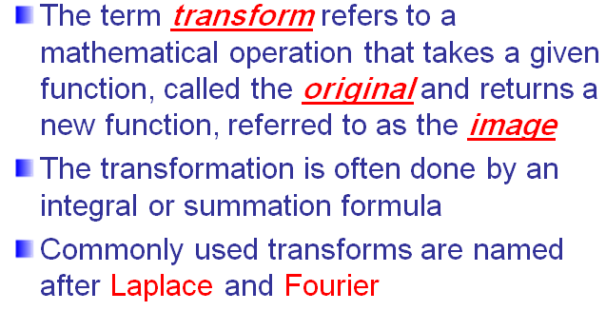
What are Transforms
Dr. Ali J. Abboud

Slide 4
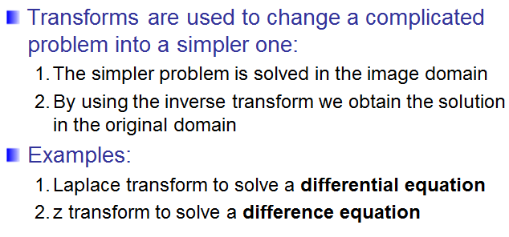
What Do We Use Transforms
Dr. Ali J. Abboud

Slide 5
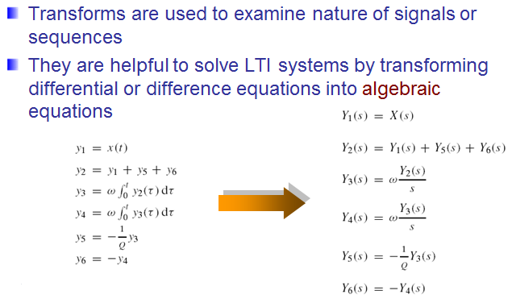
Benefits of Transforms
Dr. Ali J. Abboud

Slide 6
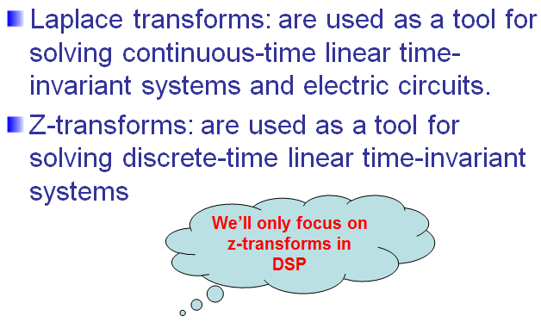
Z-Transforms
Dr. Ali J. Abboud

Slide 7
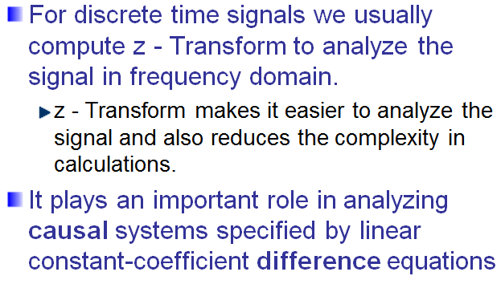
Z-Transforms
Dr. Ali J. Abboud

Slide 8
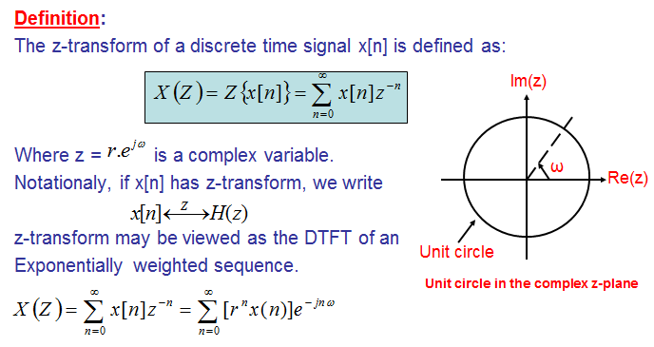
Definition of Z-Transforms
Dr. Ali J. Abboud

Slide 9
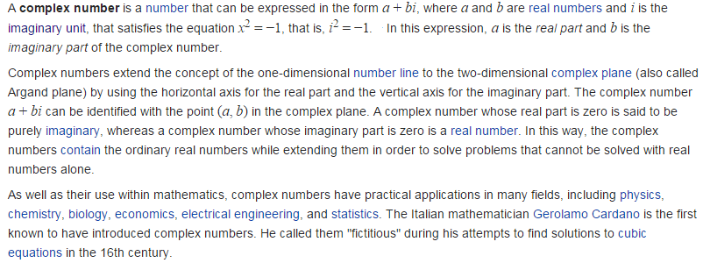
Complex Numbers
Dr. Ali J. Abboud

Slide 10
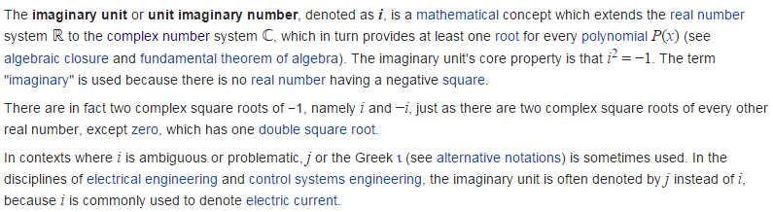
Complex Numbers
Dr. Ali J. Abboud

Slide 11
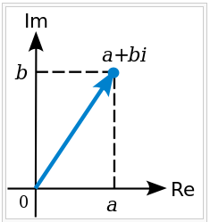
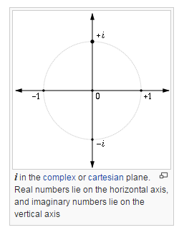
Complex Numbers
Dr. Ali J. Abboud

Slide 12
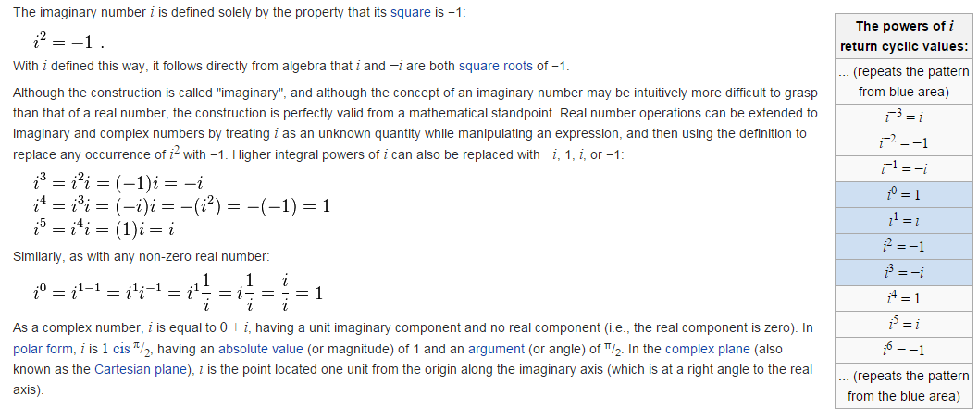
Complex Numbers
Dr. Ali J. Abboud

Slide 13
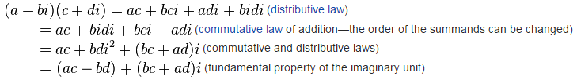

Complex Numbers
Dr. Ali J. Abboud

Slide 14
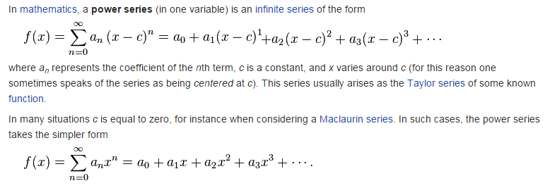
Power Series
Dr. Ali J. Abboud

Slide 15


Power Series
Dr. Ali J. Abboud

Slide 16
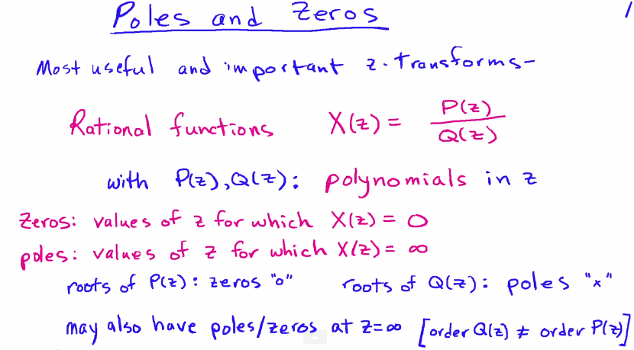
Poles and Zeros of Z-Transform
Dr. Ali J. Abboud

Slide 17
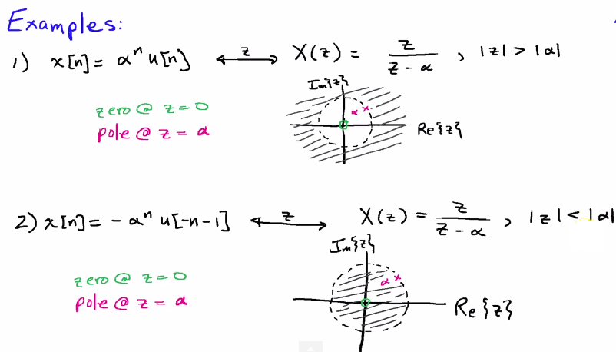
Poles and Zeros of Z-Transform
Dr. Ali J. Abboud

Slide 18
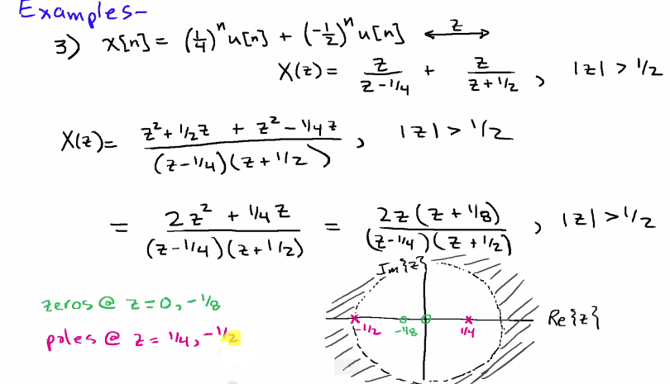
Poles and Zeros of Z-Transform
Dr. Ali J. Abboud

Slide 19
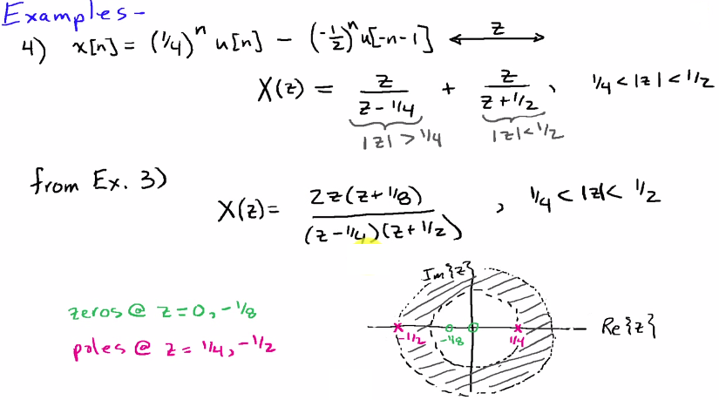
Poles and Zeros of Z-Transform
Dr. Ali J. Abboud

Slide 20
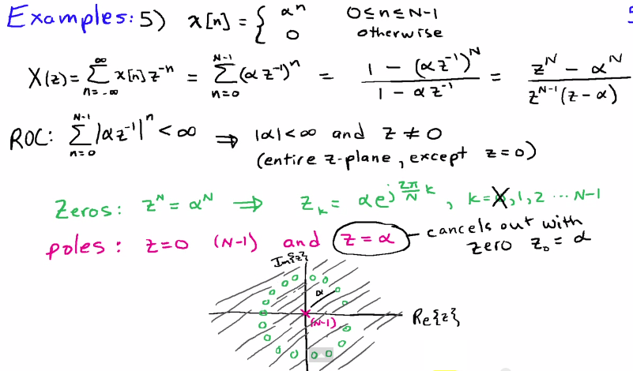
Poles and Zeros of Z-Transform
Dr. Ali J. Abboud

Slide 21
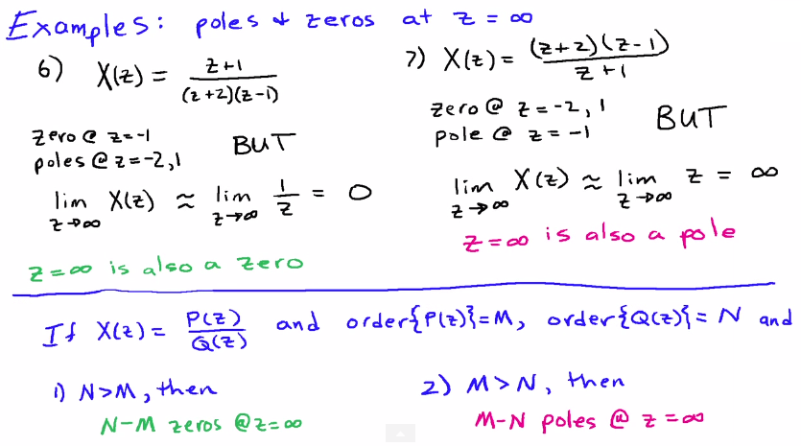
Poles and Zeros of Z-Transform
Dr. Ali J. Abboud

Slide 22
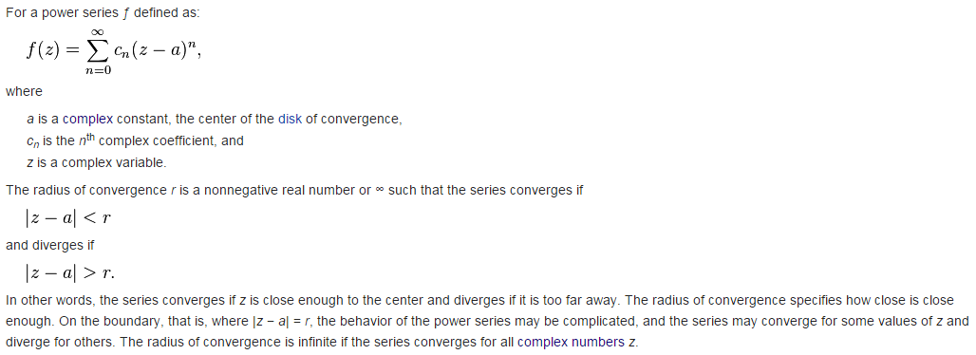
Radius of Convergence
Dr. Ali J. Abboud

Slide 23
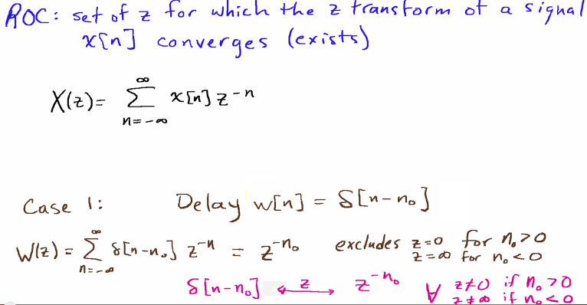
Region of Convergence (ROC)
Dr. Ali J. Abboud

Slide 24
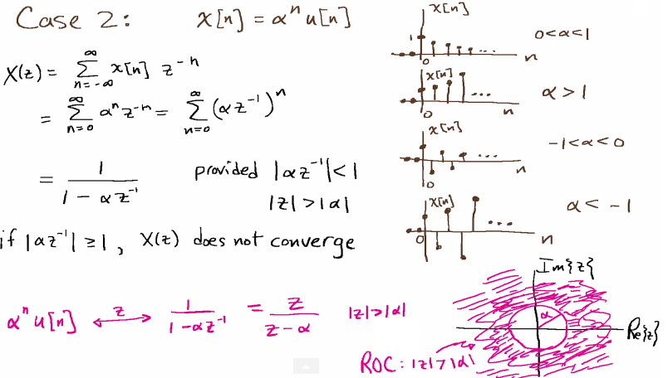
Region of Convergence (ROC)
Dr. Ali J. Abboud

Slide 25
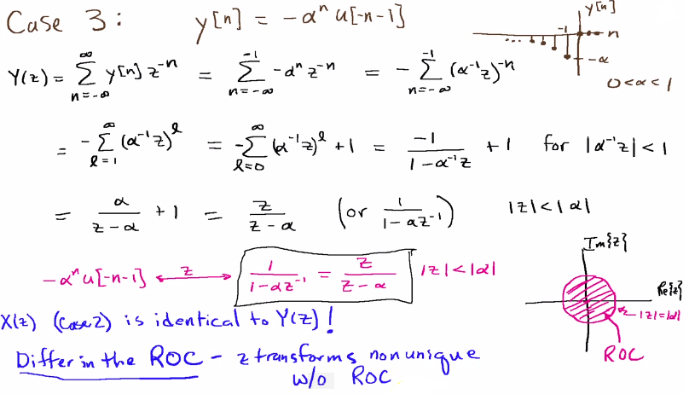
Region of Convergence (ROC)
Dr. Ali J. Abboud

Slide 26
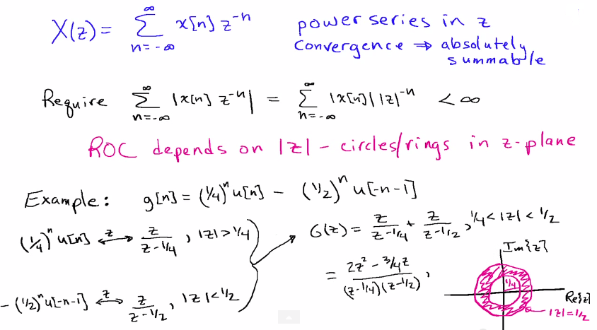
Region of Convergence (ROC)
Dr. Ali J. Abboud

Slide 27
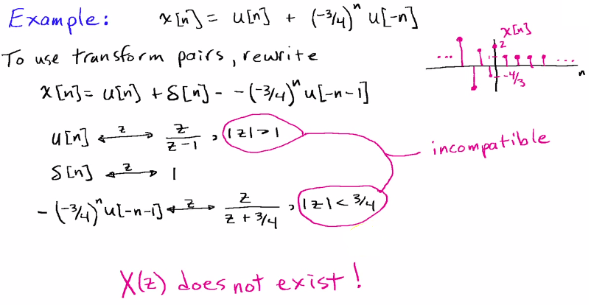
Region of Convergence (ROC)
Dr. Ali J. Abboud

Slide 28
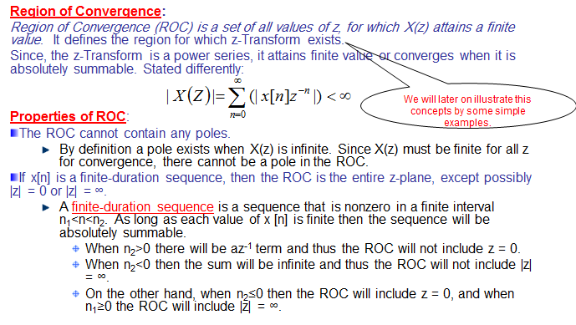
Region of Convergence (ROC)
Dr. Ali J. Abboud

Slide 29
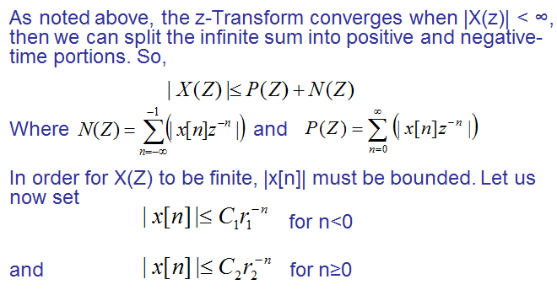
Region of Convergence
Dr. Ali J. Abboud

Slide 30
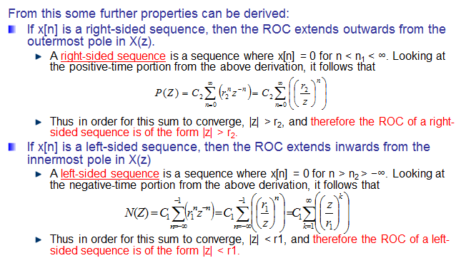
Region of Convergence
Dr. Ali J. Abboud

Slide 31
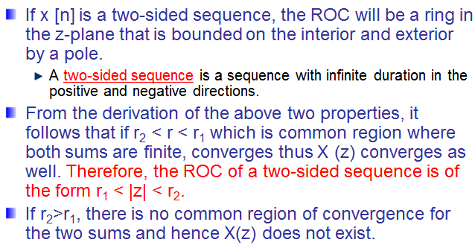
Region of Convergence
Dr. Ali J. Abboud

Slide 32
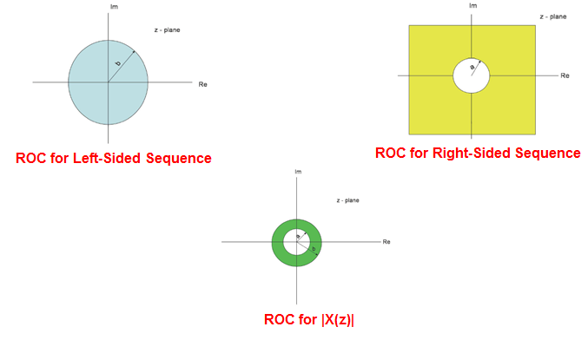
Region of Convergence
Dr. Ali J. Abboud

Slide 33
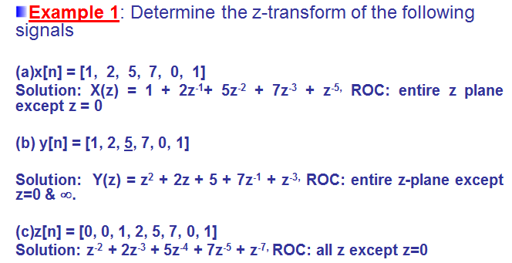
Examples
Dr. Ali J. Abboud

Slide 34
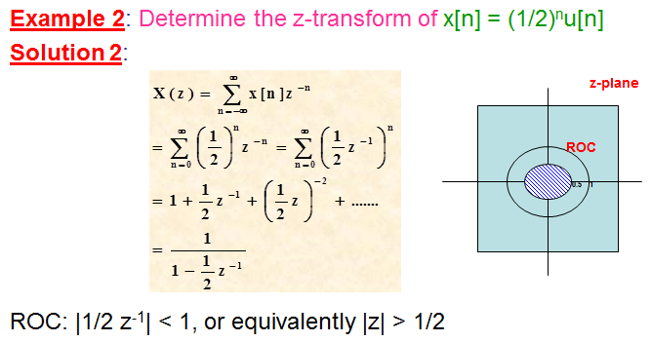
Examples
Dr. Ali J. Abboud

Slide 35
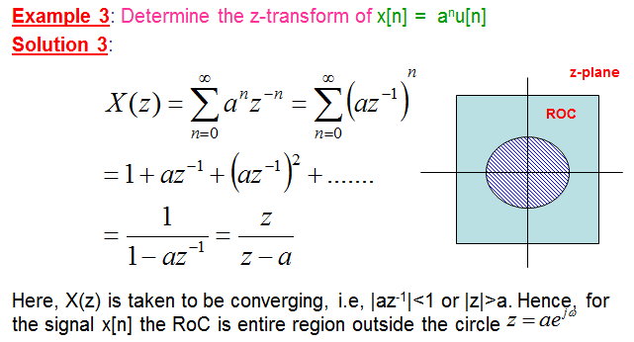
Examples
Dr. Ali J. Abboud

Slide 36
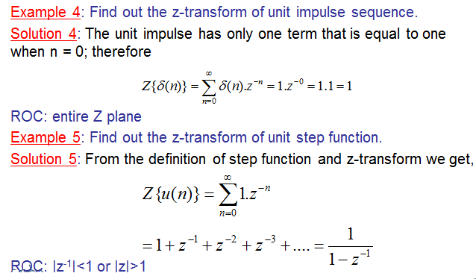
Examples
Dr. Ali J. Abboud

Slide 37
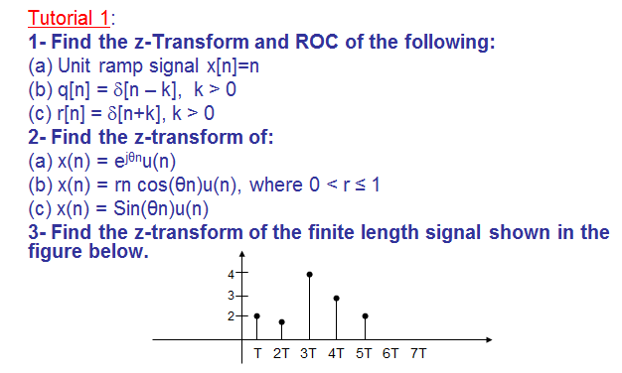
Tutorial
Dr. Ali J. Abboud

Slide 38
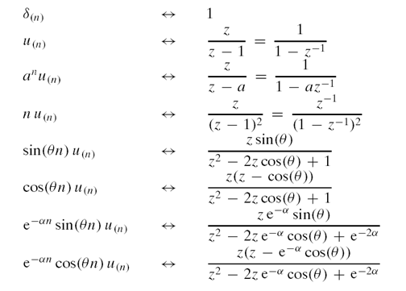
Z-Transform Pairs
Dr. Ali J. Abboud

Slide 39
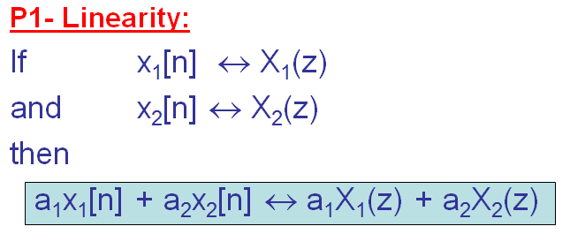
Properties of Z-Transform
Dr. Ali J. Abboud

Slide 40
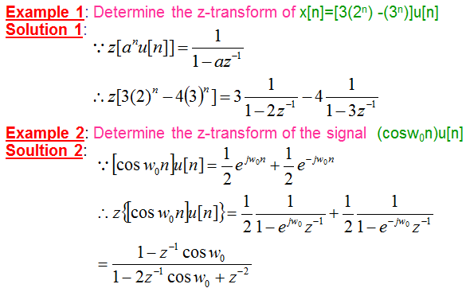
Properties of Z-Transform
Dr. Ali J. Abboud

Slide 41
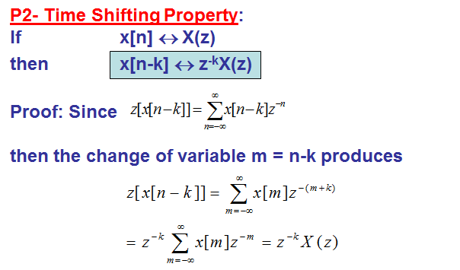
Properties of Z-Transform
Dr. Ali J. Abboud

Slide 42
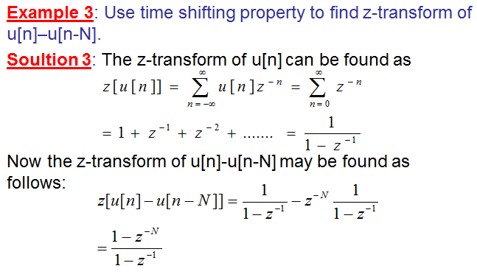
Properties of Z-Transform
Dr. Ali J. Abboud

Slide 43
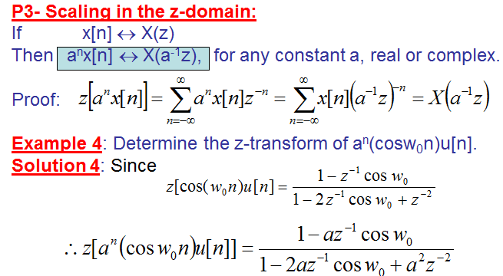
Properties of Z-Transform
Dr. Ali J. Abboud

Slide 44
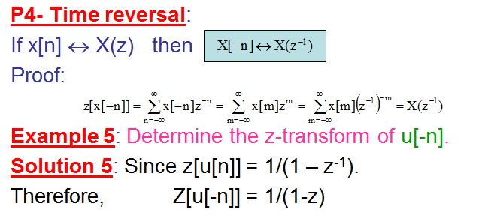
Properties of Z-Transform
Dr. Ali J. Abboud

Slide 45
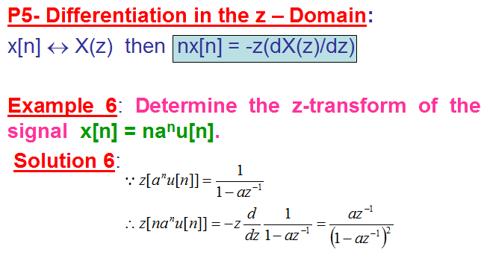
Properties of Z-Transform
Dr. Ali J. Abboud

Slide 46
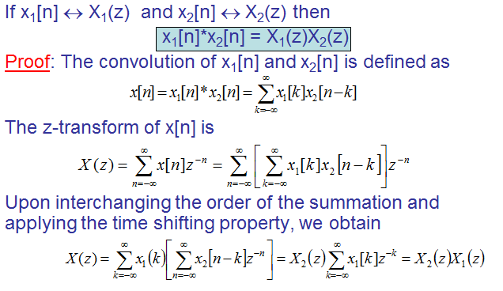
Convolution in Z-Transform
Dr. Ali J. Abboud

Slide 47
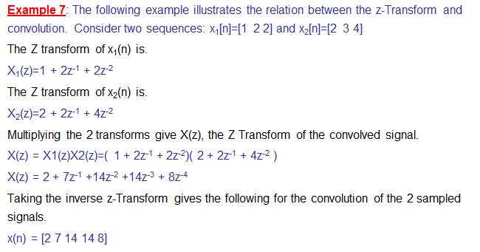
Convolution in Z-Transform
Dr. Ali J. Abboud

Slide 48
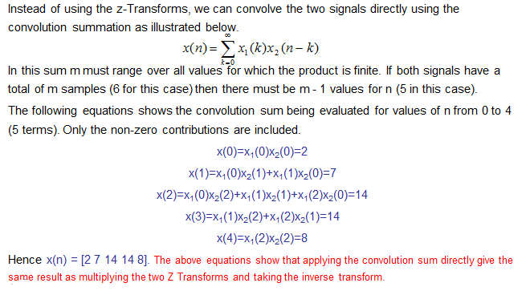
Convolution in Z-Transform
Dr. Ali J. Abboud

Slide 49
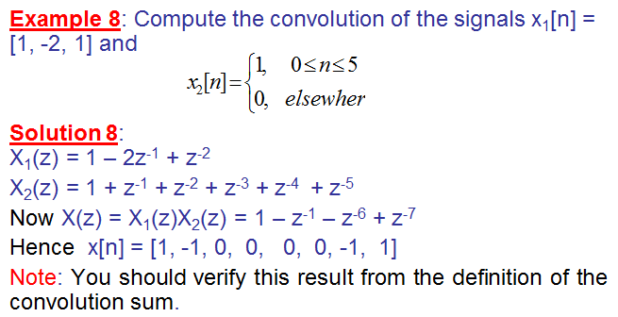
Convolution in Z-Transform
Dr. Ali J. Abboud

Slide 50
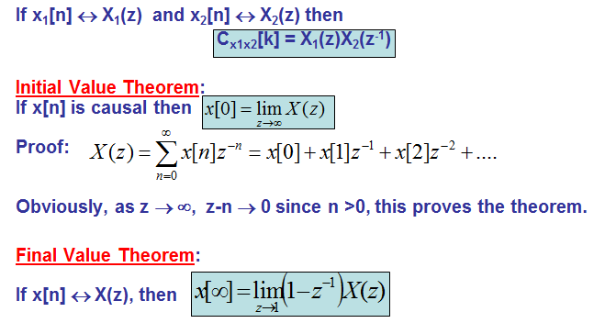
Correlation in Z-Transform
Dr. Ali J. Abboud

Slide 51
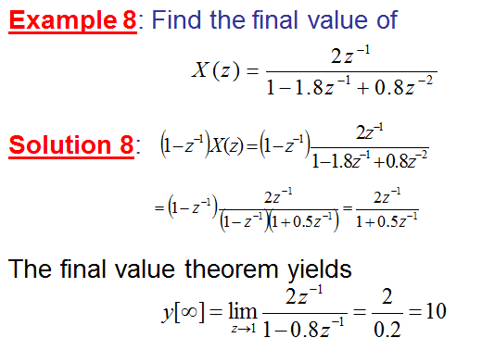
Examples
Dr. Ali J. Abboud

Slide 52
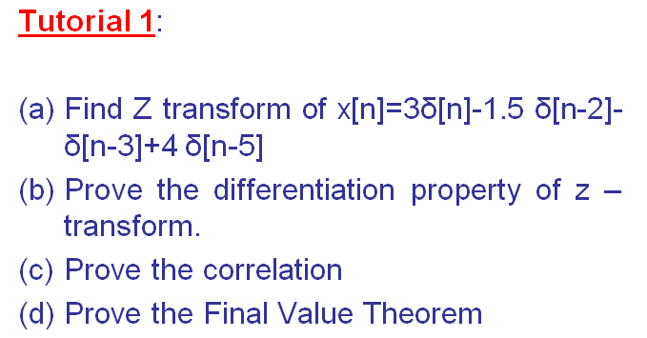
Tutorial
Dr. Ali J. Abboud

Slide 53

Inverse Z-Transform
Dr. Ali J. Abboud

Slide 54

Power Series Expansion
Dr. Ali J. Abboud

Slide 55

Power Series Expansion
Dr. Ali J. Abboud

Slide 56

Power Series Expansion
Dr. Ali J. Abboud

Slide 57

Power Series Method
Dr. Ali J. Abboud

Slide 58

Power Series Method
Dr. Ali J. Abboud

Slide 59

Power Series Method
Dr. Ali J. Abboud

Slide 60

Example1: Partial Fraction
Dr. Ali J. Abboud

Slide 61

Example1: Partial Fraction
Dr. Ali J. Abboud

Slide 62

Example2: Partial Fraction
Dr. Ali J. Abboud

Slide 63

Example2: Partial Fraction
Dr. Ali J. Abboud

Slide 64

Example3: Partial Fraction
Dr. Ali J. Abboud

Slide 65

Example3: Partial Fraction
Dr. Ali J. Abboud

Slide 66


Example4: Partial Fraction
Dr. Ali J. Abboud

Slide 67

Example5: Partial Fraction
Dr. Ali J. Abboud

Slide 68

Example5: Partial Fraction
Dr. Ali J. Abboud

Slide 69

Partial Fraction Method
Dr. Ali J. Abboud

Slide 70

Partial Fraction Method
Dr. Ali J. Abboud

Slide 71

Partial Fraction Method
Dr. Ali J. Abboud

Slide 72

Partial Fraction Method
Dr. Ali J. Abboud

Slide 73

Partial Fraction Method
Dr. Ali J. Abboud

Slide 74

Partial Fraction Method
Dr. Ali J. Abboud

Slide 75

Partial Fraction Method
Dr. Ali J. Abboud

Slide 76

Partial Fraction Method
Dr. Ali J. Abboud

Slide 77

Z-Transform Solution of Linear Difference Equations
Dr. Ali J. Abboud

Slide 78

Z-Transform Solution of Linear Difference Equations
Dr. Ali J. Abboud

Slide 79

Z-Transform Solution of Linear Difference Equations
Dr. Ali J. Abboud

Slide 80

Tutorial
Dr. Ali J. Abboud

Slide 81
End of Chapter
Dr. Ali J. Abboud

